Slide 1
Emory University
2011 Department of Gynecology & Obstetrics Graduation and Awards Banquet
June 10, 2011

Slide 2
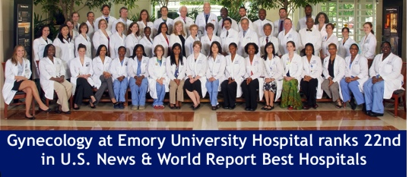
Thank You To All Faculty…

Slide 3
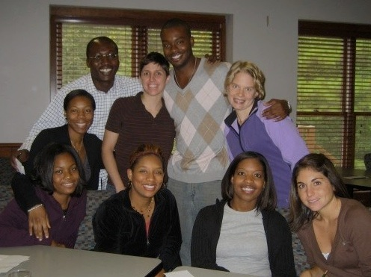
The PGY4’s as PGY1’s . . . .
Tuuli
David
Goedken
Beverly
Becky
Shontell
Dana
Kawasaki
Henderson

Slide 4
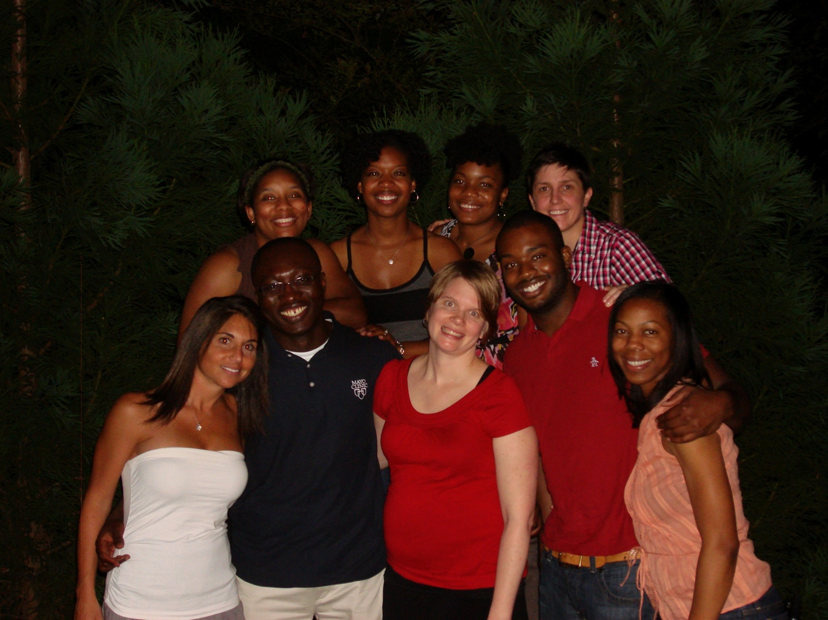
And Now As PGY4’s . . . A Brief “Roast” Quirks we’ve discovered over the years

Slide 5
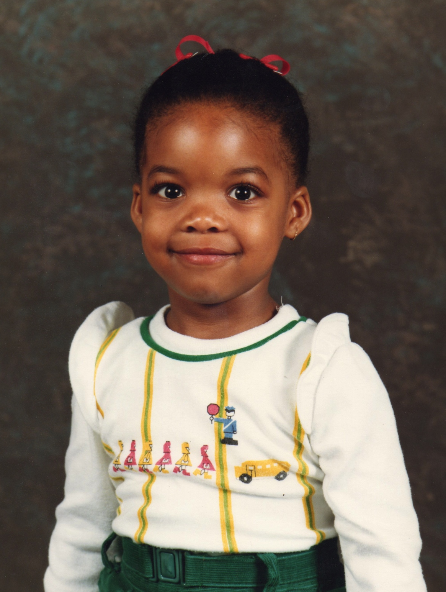
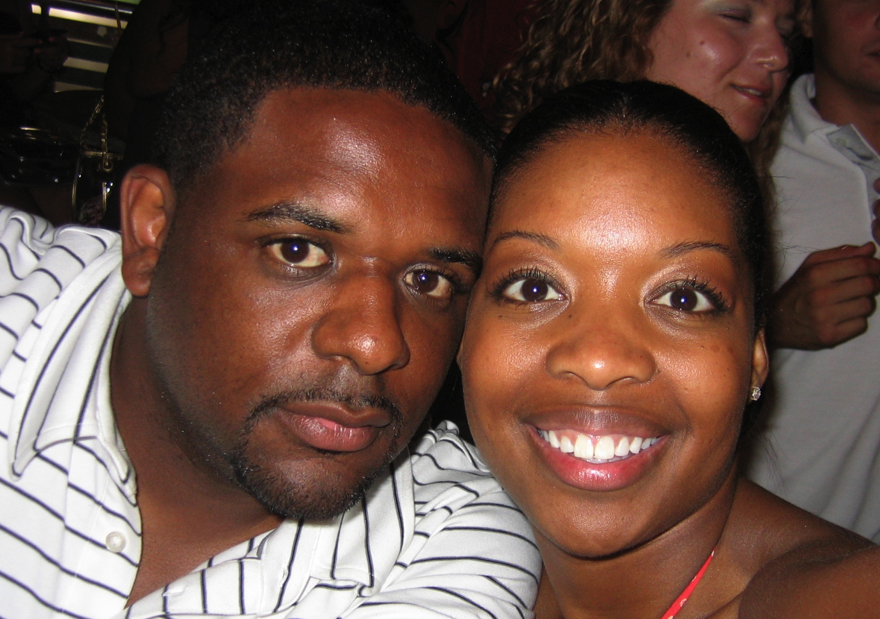
Rebecca Nickerson Williams
Birthplace: Wuerzburg, Germany
Hometown: None (Adopted hometown: Atlanta, GA)
Undergrad: Florida A&M University (FAMU)
Medschool: Florida State University College of Medicine
“Fun Fact”: Born and raised an Army Brat. My family and I moved 9 times before I went to college.
Future Plans: Private Practice - Maternal Gynerations, PC - Lawrenceville, GA

Slide 6
Top things we’ve learned about Rebecca…

Slide 7
Queen Among Women

Slide 8
Soft Spoken

Slide 9
Delicate

Slide 10
Things You Didn’t Know…
She has a passion for sickle cell disease
She loves to share
She considered doing a Gyn Onc Fellowship
She is quite the wordsmith
She will always let someone know they are wrong…
She should have her own reality TV show
She is someone you can tell your most personal secrets to…
She is an excellent physician
She is an amazing friend
She will be missed by all, but especially by me
Notes:
As we all know, Rebecca did her RRD topic on Sickle Cell Disease. She is truly passionate about this topic. With a fire deep in her soul she can go ON, and ON, and ON, and ON … skip statistical analysis… and go ON and ON and ON about sickle cell disease.
Rebecca is the type of person, whom will give you her last ginger ale. She doesn’t know that she is doing it, but none the less she will let you have it. By the way, that time your ginger ale went missing and I said Kenan Omurtag drank it. I lied, it was me, and the ginger ale was delicious, it was refreshing, it was crisp, it tasted like the first day of fall, and I even think there was a pinch of cinnamon in there.
Don’t worry she only considered it for five minutes
When Rebecca talks, she uses the swift and direct syntax of Ernest Hemingway with eloquence and vernacular of Richard Pryor. She is one of the few people whom all of her four word sentences, also have four letter words
Unless that someone is her
She is joining a practice with the infamous Melanie Watkins, class of 2010. That show would do quite well. It could be on Vh1, Bravo,or Lifetime, but it’s probably more suited for Animal Planet or Court TV.
If you want everyone to know your most personal secrets

Slide 11
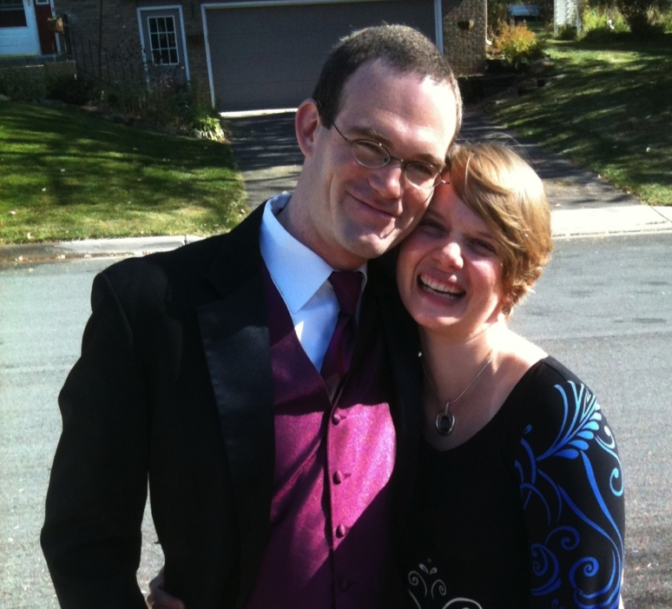
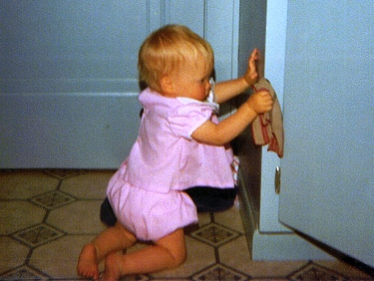
Katie Johnson Gray (Groendyke)
Birthplace: Madison, Wisconsin
Hometown: West Bend, Wisconsin
Undergrad: University of Wisconsin-Madison
Medschool: University of Michigan
“Fun Fact”: A fellow classmate named me the “spice girl” . . .
Future Plans: Combined MFM-Genetics fellowship, Brigham & Women’s /Children’s Hospital, Boston

Slide 12
Top things we’ve learned about Katie…
The only resident who has had three last names in the past 4 years.
After several long talks about her life, you always leave thirsting for more, which she will always give you; yet you often leave feeling even more intrigued…and a little dirty.
The kind of person who will stand up for what is right (and dammit, she always seems to know exactly what that is!), no matter how much it will disappoint the person who is wrong.
After a night of solid drinking, her urine makes any garden flourish.
Everyone can count on Katie to know exactly what their schedule is, and where they are supposed to be…at all times!!!
You can always know whether or not Katie agrees with someone’s explanation or answer to a pimping questions by looking at the way her head is shaking from her seat or the back of the room.
There’s no other person I would have rathered had to run to the intern room and cried with in July 2007
So thrilled for Katie that she is finally getting everything she’s wanted (i.e. Loving and supportive husband … and Baby!!!)

Slide 13
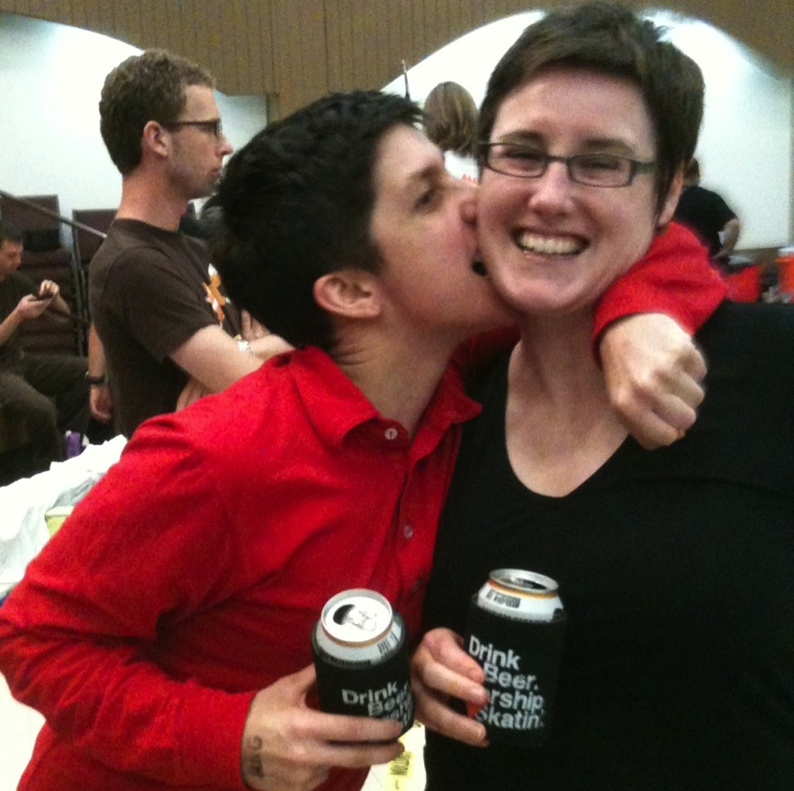
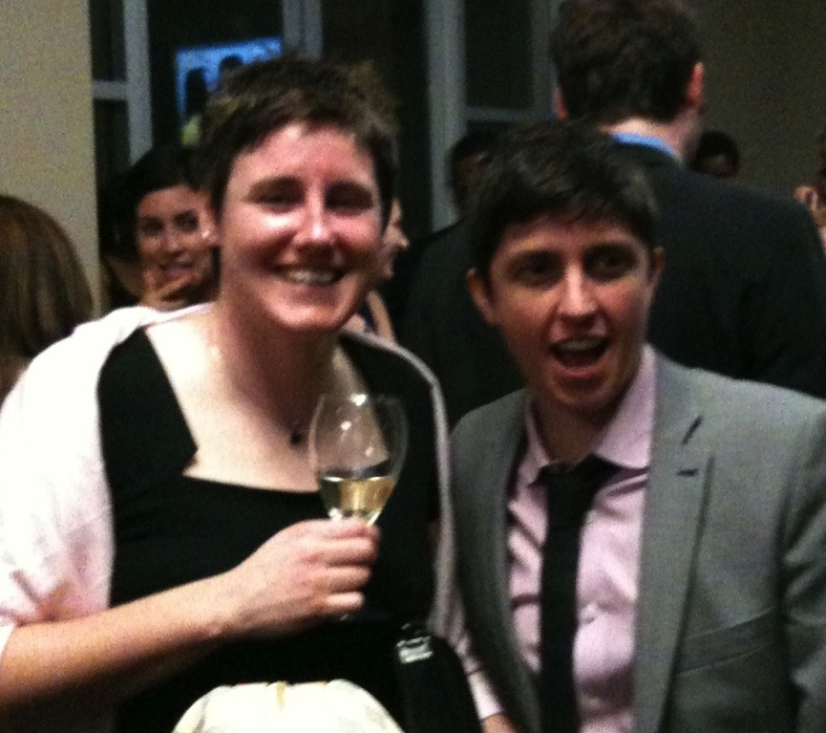
Betsy Collins
Birthplace: Cleveland, Ohio
Undergrad: University of Texas
Medschool: Ohio State
“Fun Fact”: A rabbit bit off one of my fingers when I was 2
Future Plans: Emory faculty member

Slide 14
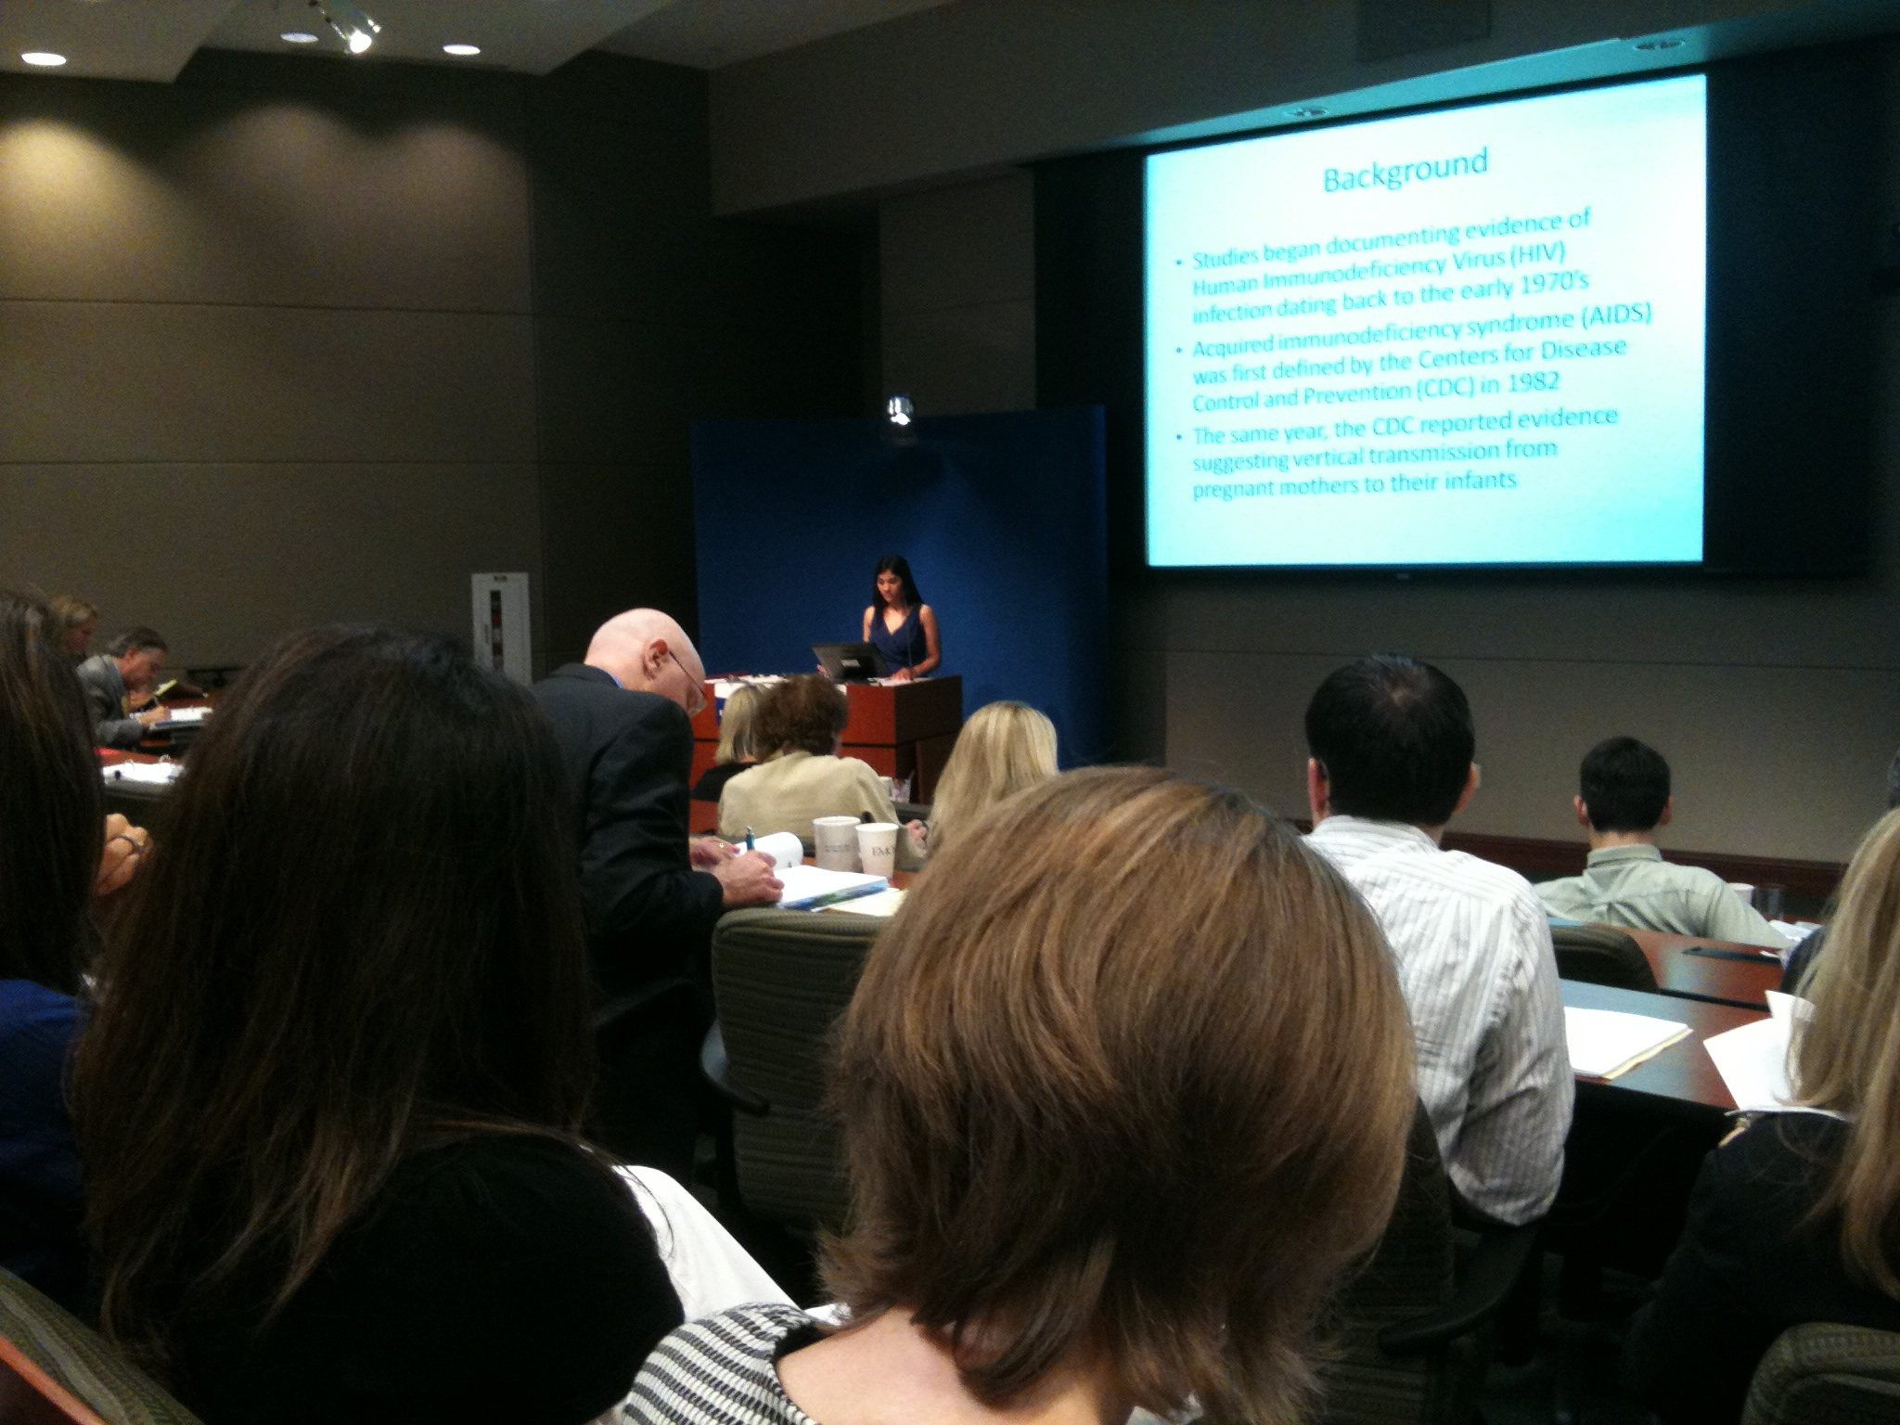
Top things we’ve learned about Betsy…
She’s never afraid to speak her mind . . . wherever and whenever
Anyone recall RRD as interns?

Slide 15
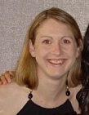
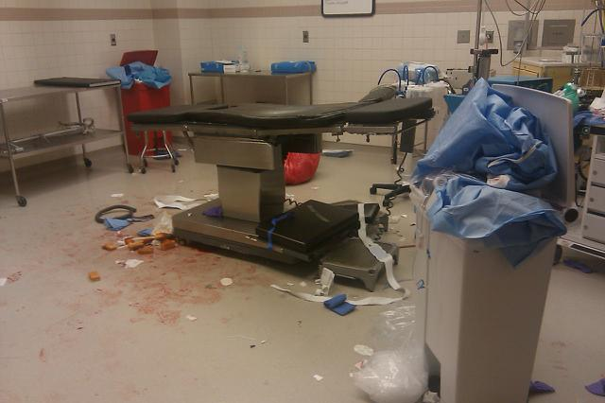
Top things we’ve learned about Betsy…
Is still in a contest with Patty Fennessey for the worst black cloud on L & D . . .
D & C hysterectomy anyone?

Slide 16
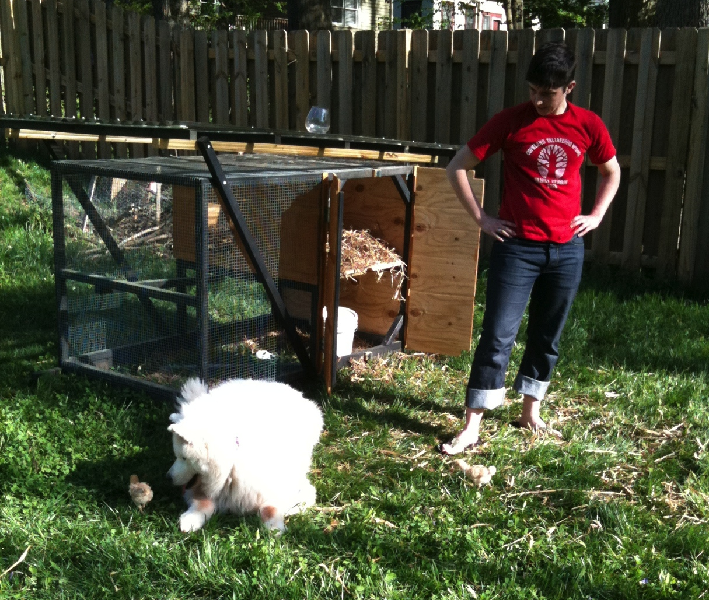
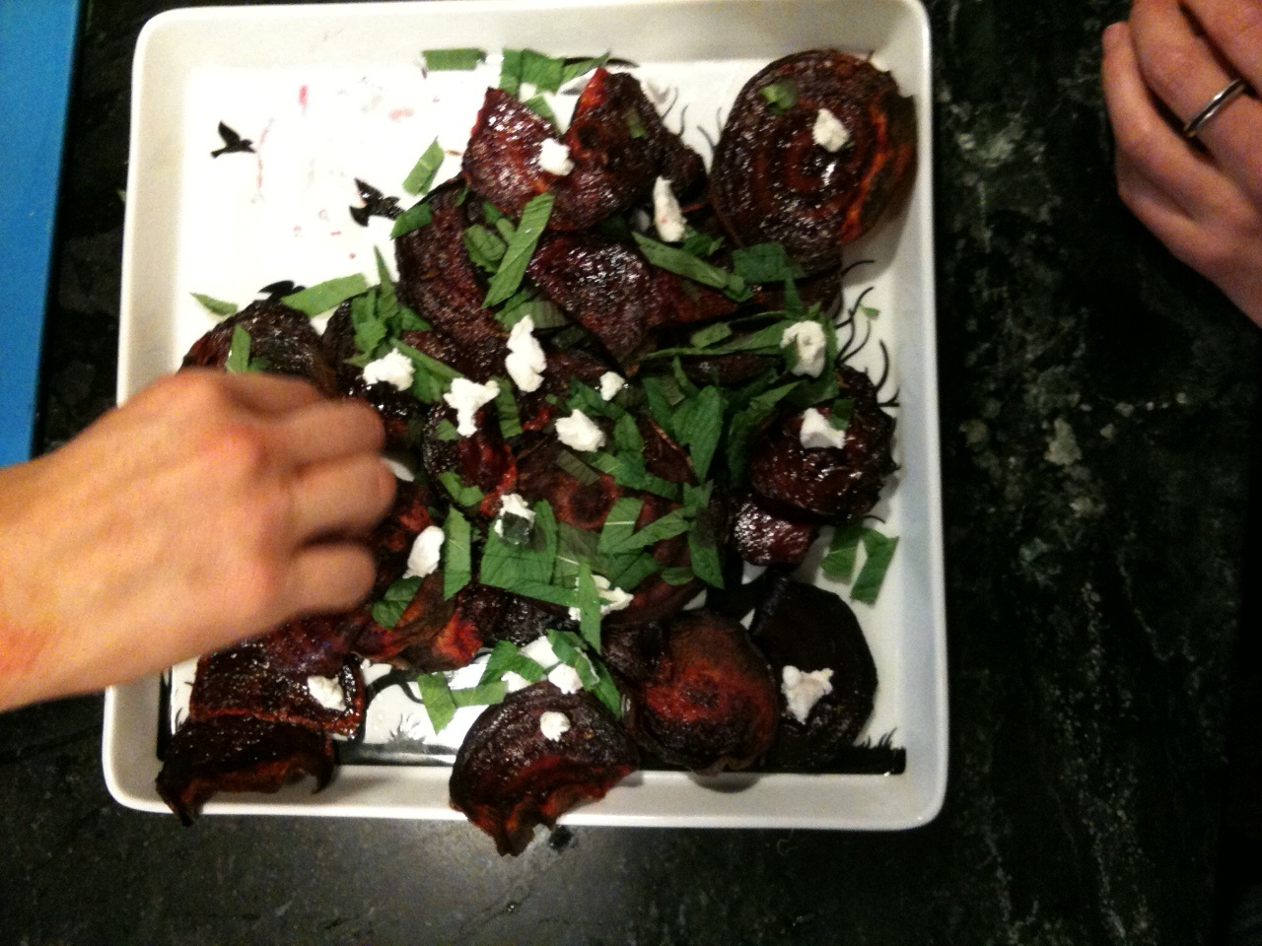
Top things we’ve learned about Betsy…
Notably, clearly could have had many less stressful careers . . .
-- Chef
-- Gardner
-- Farmer
-- Carpenter
-- Barber
-- Personal shopper

Slide 17
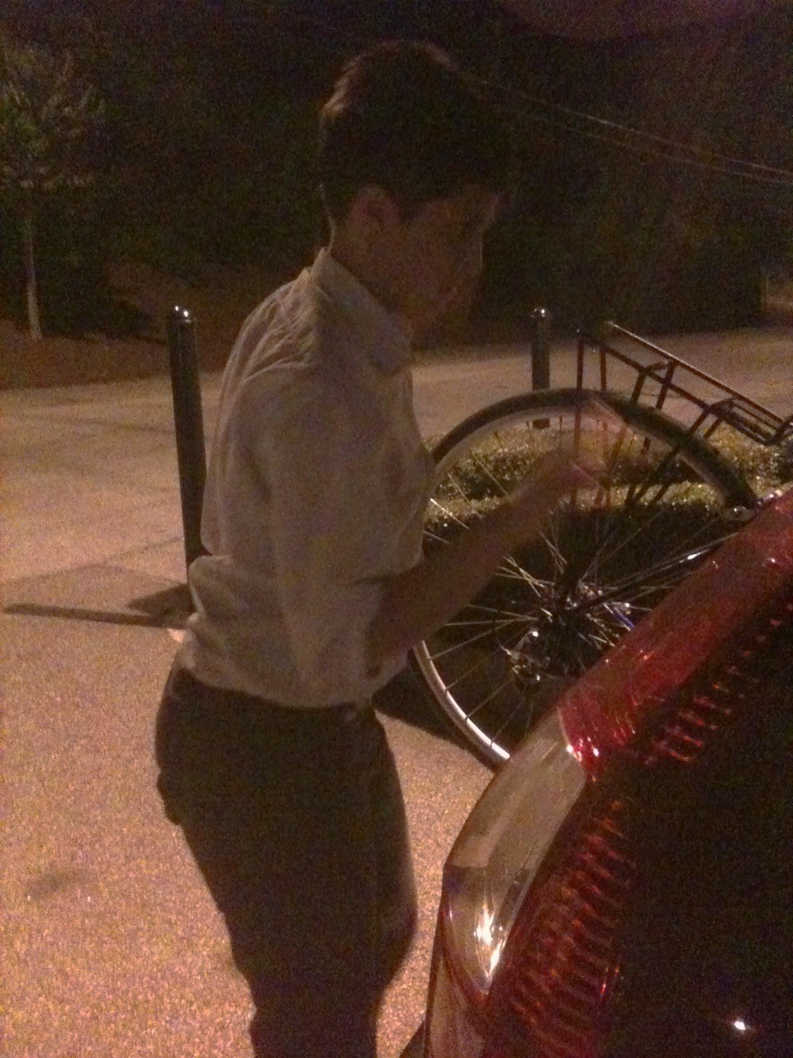
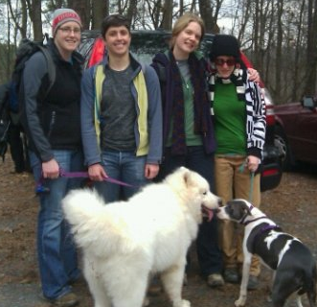
Top things we’ve learned about Betsy…
Was hired by Al Gore to renew interest in environmental issues among residents . . .

Slide 18
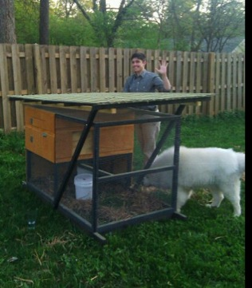
Top things we’ve learned about Betsy…
Is the most likely resident to be found constructing a chicken coop on her vacation . . .

Slide 19
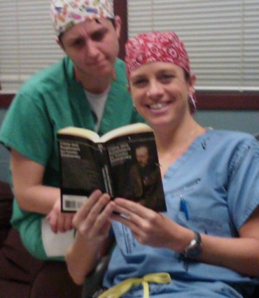
Top things we’ve learned about Betsy…
And the most likely culprit to have left the NY Times open on the PGY4 computer on L & D (or be found reading Crime & Punishment). . .

Slide 20
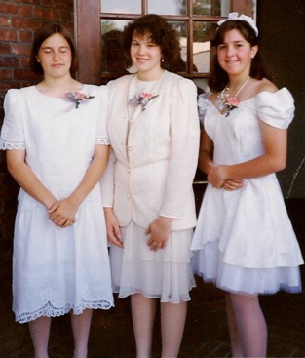
Top things we’ve learned about Betsy…
May be the least likely member of the department to be found wearing a dress . . .
Can you guess which one is Betsy?

Slide 21
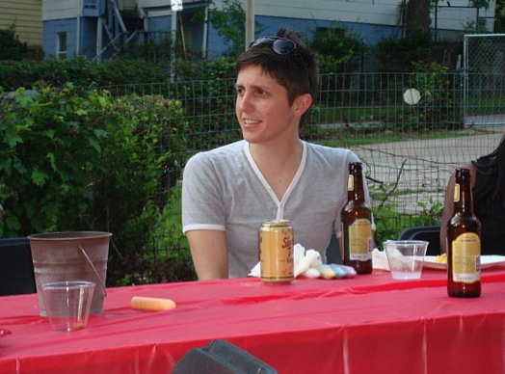
Top things we’ve learned about Betsy…
Always game for a gathering that involves good food and beer . . .

Slide 22
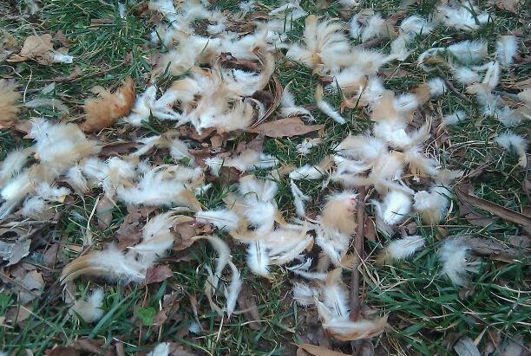
Top things we’ve learned about Betsy…
Her backyard could double as an alternative filming site for Crocodile Hunter . . .
Hawk 2. Chickens 0.

Slide 23
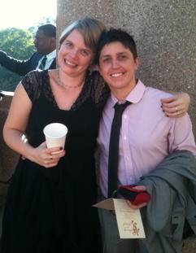
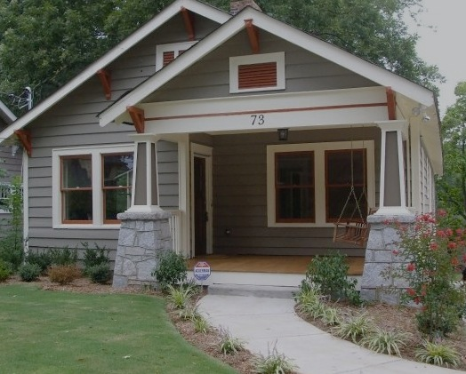
Top things we’ve learned about Betsy…
She’s an incredible friend who has an amazing capacity for hospitality.

Slide 24
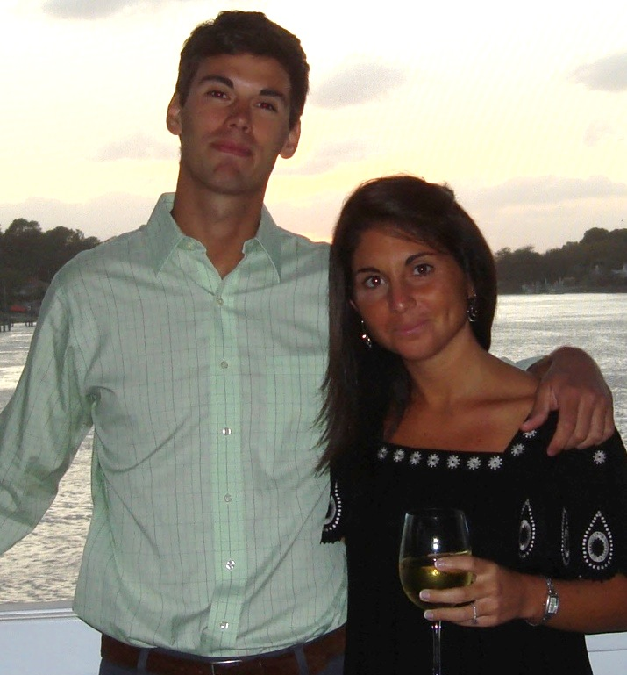
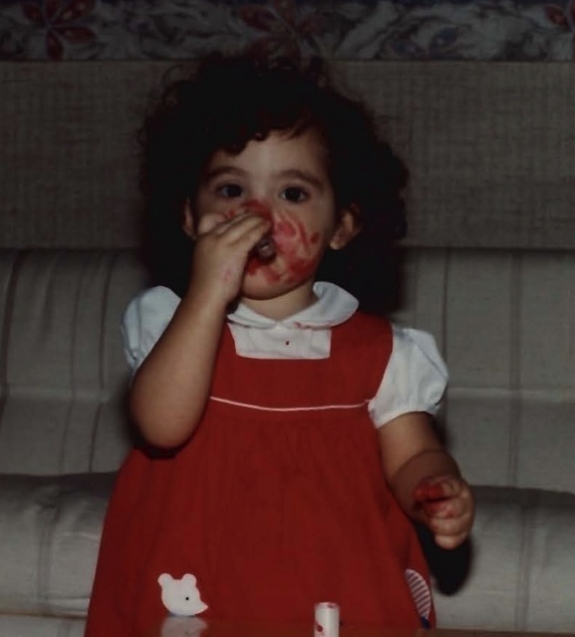
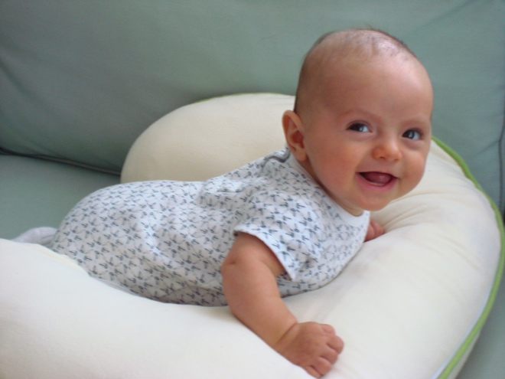
Jennifer Fay Kawwass-Thompson
Birthplace: New York, NY
Hometown: Virginia Beach, VA
Undergrad: Davidson College
Medschool: University of Virginia
“Fun Facts”:
Played Division I Field Hockey and was nicknamed “Deez” because she could bench press the most weight on the team…
Fluent in Spanish, French, Arabic, English… “survival” Italian
Future Plans: Emory REI Fellowship

Slide 25
Top things we’ve learned about JENN…
Voted most likely to cry during the senior roast.

Slide 26
Comments:
Most are jealous of Jenn’s ability to nap anywhere at any time.
Jenn is in a neck and neck competition with Albert for who is less interested in L&D
We’ll be hitting Jenn up for reimbursement to cover the expense of our unlimited text plans (required if you want to communicate with her)

Slide 27
Comments continued…
Jenn has been elected as the new apple industry spokesperson after it was discovered that she has eaten more apples than any other American since 2001.
Jenn drives like Mario Andretti in the Grady parking lot to obtain her coveted spot.

Slide 28
Comments continued…
“Jenn’s RRD presentation was like seeing an M. Knight Shamalan movie-the graphics were great, it was intellectually stimulating, I was intrigued the whole time, but at the end, I had no clue what the whole thing was about.”

Slide 29
Jenn’s Place in the Universe
Jenn
Verizon
Berga
Roberts
AT&T
Horowitz
God

Slide 30
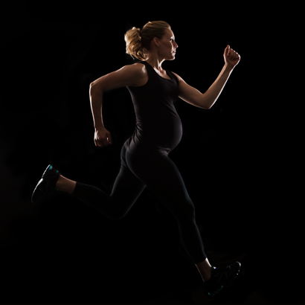
Henry Wyatt Thompson shaken fetus society

Slide 31
Damn that perfect chief!

Slide 32
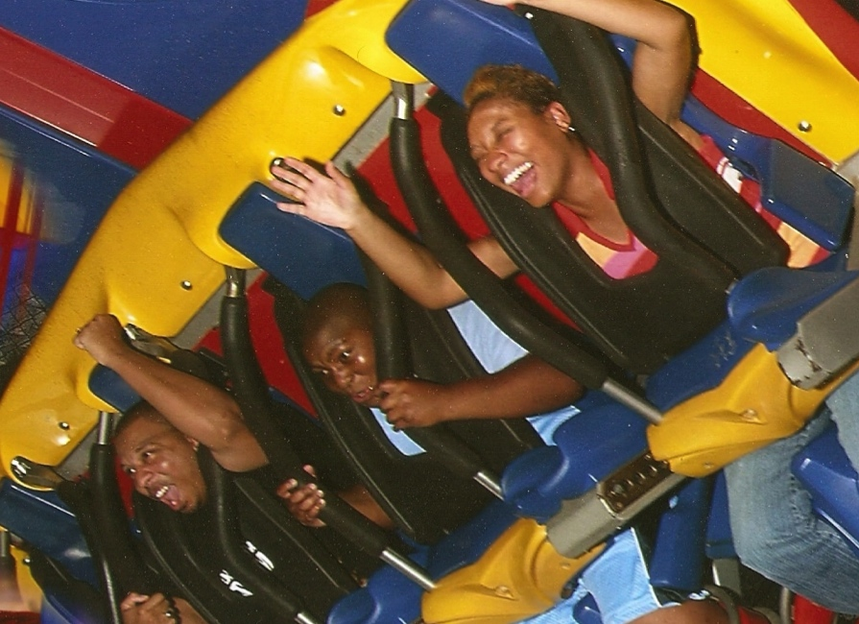
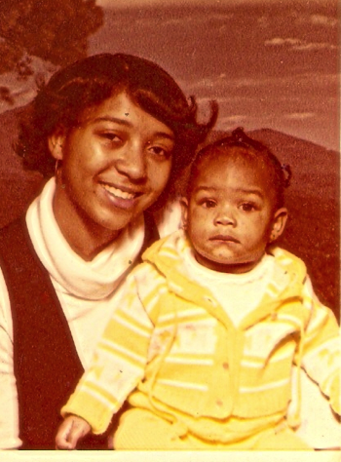
Shontell Nakisha Thomas
Birthplace: New Orleans, LA
Hometown: New Orleans, LA
Undergrad: UNC-Chapel Hill
Medschool: UNC-Chapel Hill
“Fun Fact”: This is the longest my hair has been since starting residency; this is actually my natural hair color
Future Plans: Work with group practice at Ochsner Health Systems in Kenner, LA

Slide 33
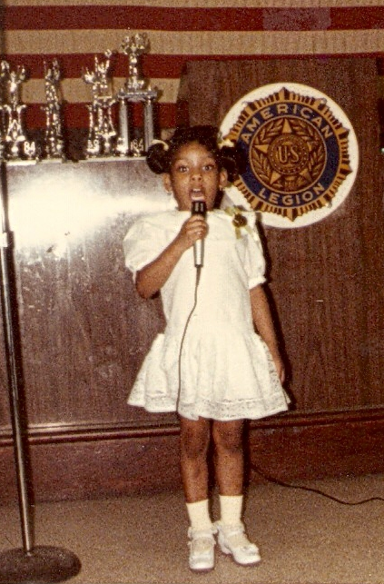
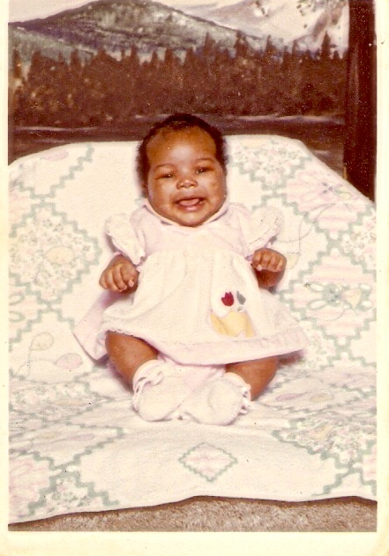
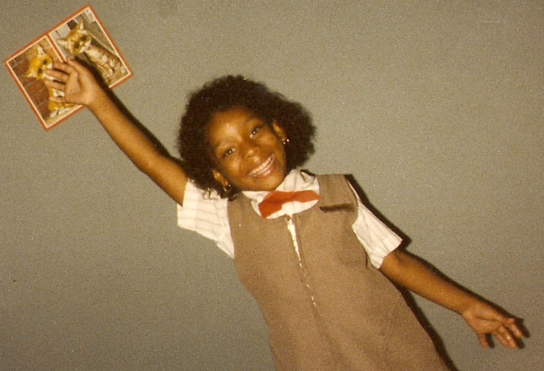

Slide 34
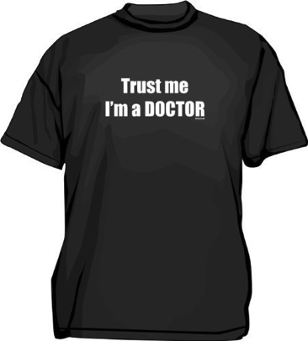
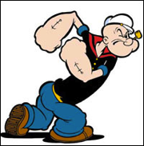
Top 10 quirks we’ve learned about Shontell…
10. Known to all med students, lower level residents,
and consulting physicians as "Dr Thomas”…
9. Unabashedly hums or sings out loud through
most of her daily activities…
8. Signs all correspondence with the closing words... "smile”
7. Will only eat food that has been deep fried...either at McDonald's or Popeye’s..
OK… or occasionally at Moe’s or IHOP

Slide 35
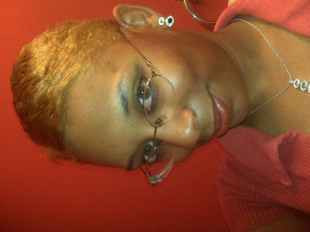
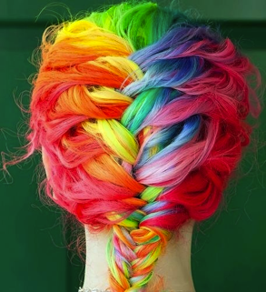
Top 10 quirks we’ve learned about Shontell…
6. Can always count on a solid 45 minute sign out about any rotation
with detailed written instructions-in case you missed anything in the 45 minute verbal sign-out…
5. Fluent in...and very eager to practice her Spanish
4. Has colored her hair nearly every color of the rainbow…

Slide 36
Top 10 quirks we’ve learned about Shontell…
3. Extremely considerate, genuine, and hard working ... and I hear she throws excellent "at work" birthday parties!
2. Always good for knowing the lyrics to an old 90s R&B song
1. American men aren't good enough; always in a love affair with an international man

Slide 37
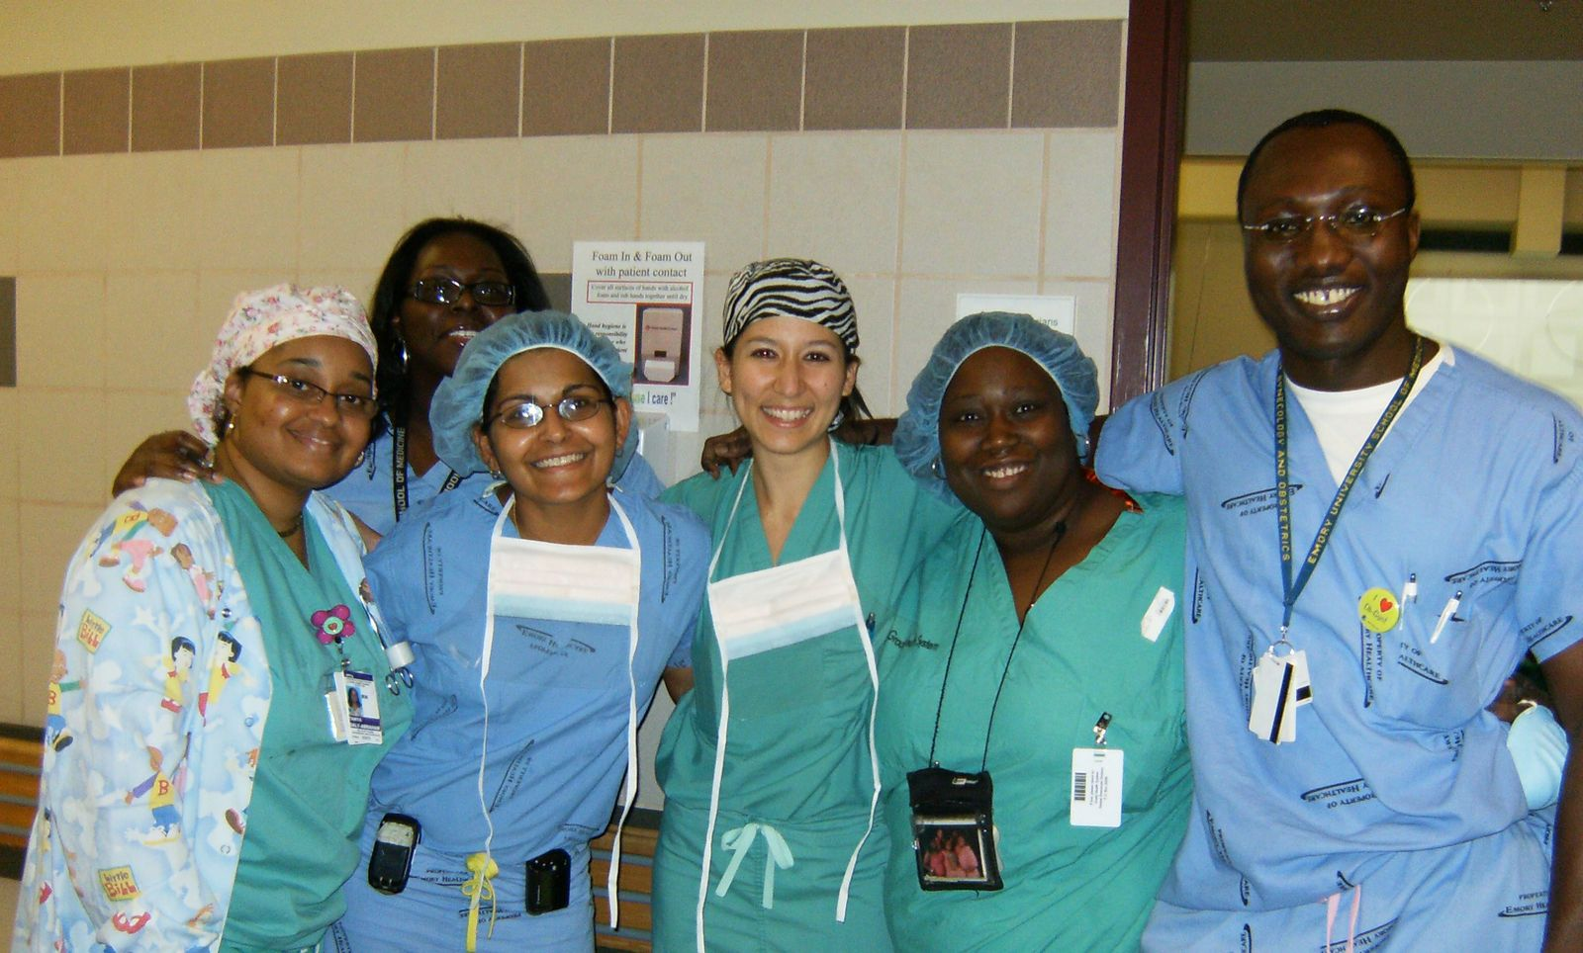
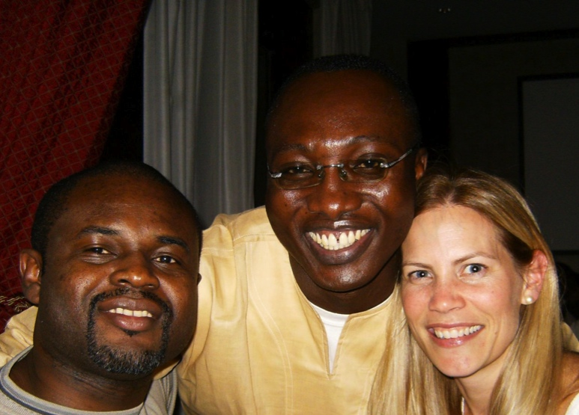
Albert Asante
Birthplace: Agogo, Ghana
Hometown: Obogu, Ghana
Undergrad: University of Ghana, BSc
Medschool: University of Ghana Medical School
Grad School: Harvard School of Public Health, MPH
"Fun Fact": obsessed with the idea of getting a SIX PACK ABS; so much so that I do at least 50 crunches a day and will almost always look at my ABS when I stand in front of a mirror (and then I will smile contentedly)!
Future Plans: - Fellowship in REI at the Mayo Clinic

Slide 38
Albert Asante
Birthplace: Agogo, Ghana
Hometown: Obogu, Ghana
Undergrad: University of Ghana, BSc
Med school: University of Ghana Medical School
Grad School: Harvard School of Public Health, MPH
Future Plans:
Next step: Fellowship in REI at “the Mayo Clinic“
Short term: To work as REI faculty in an academic institution for a few years
Long term: To work for the WHO in subsaharan Africa to "help the hundreds of thousands of women with infertility"
Notes:
-- For those of you who don’t know, Albert is from Ghana!
--He has a lot of pride for his country and tribe

Slide 39
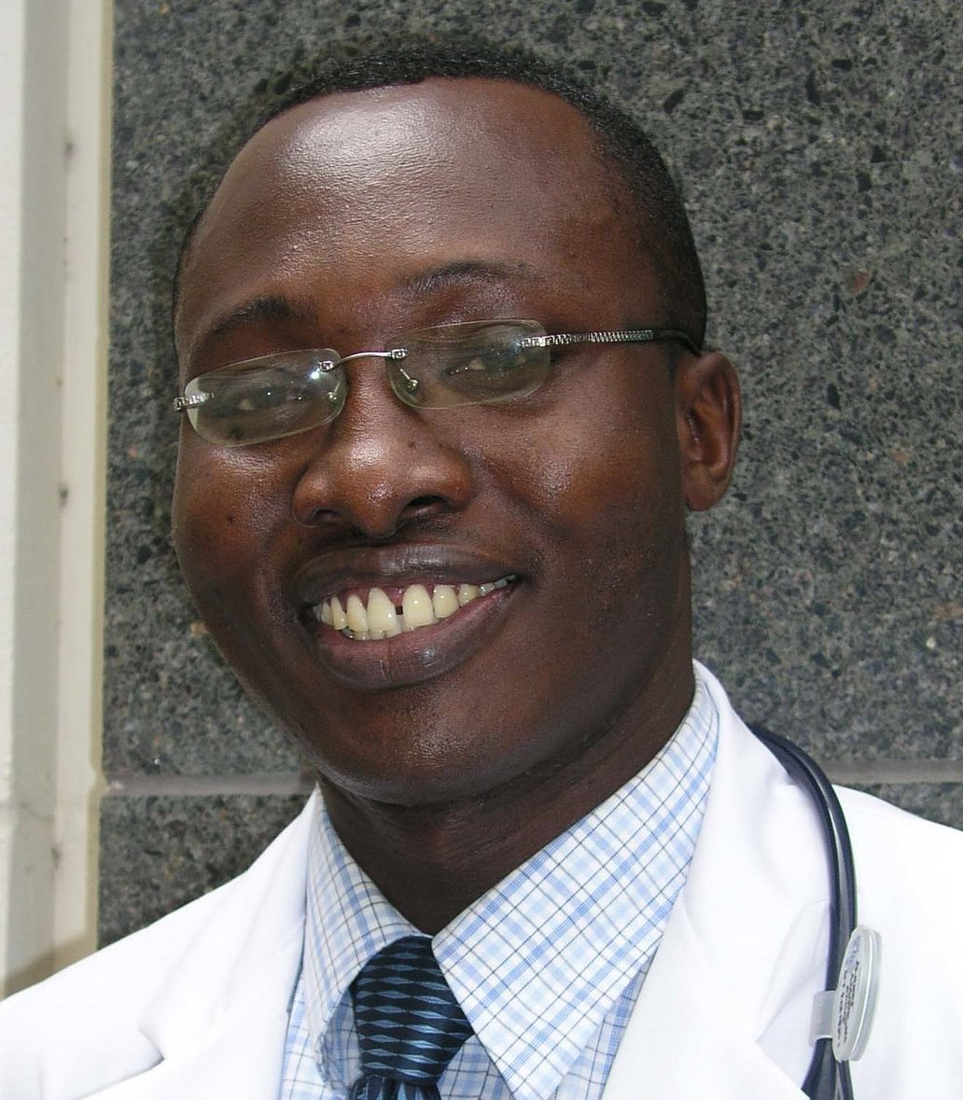
Albert Asante
Notes:
This is Albert on a good day.
This is Albert on a bad day.
This is Albert when he wakes up in the morning.
This is Albert after a really difficult C-section.

Slide 40
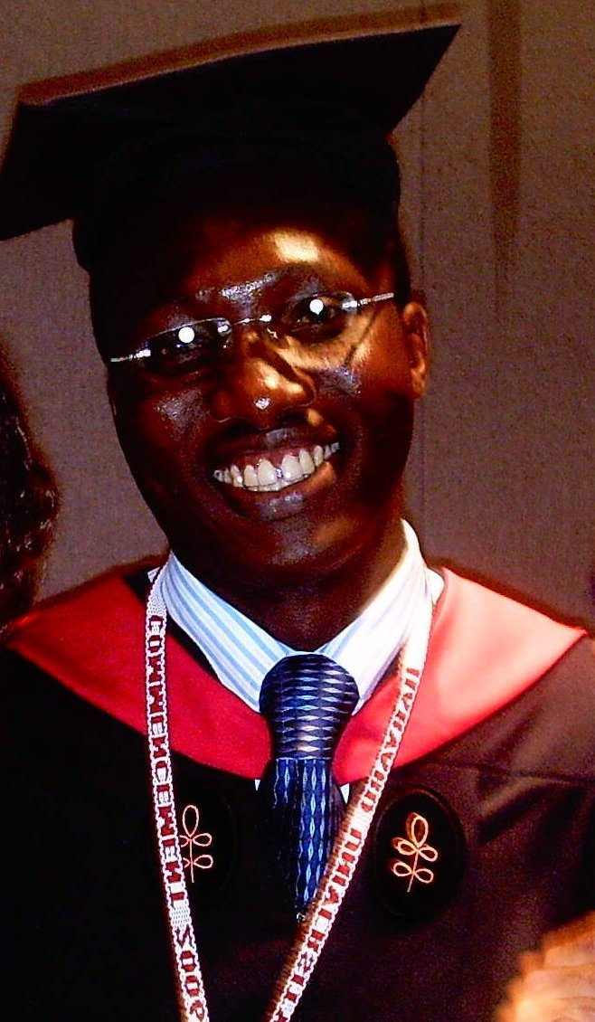
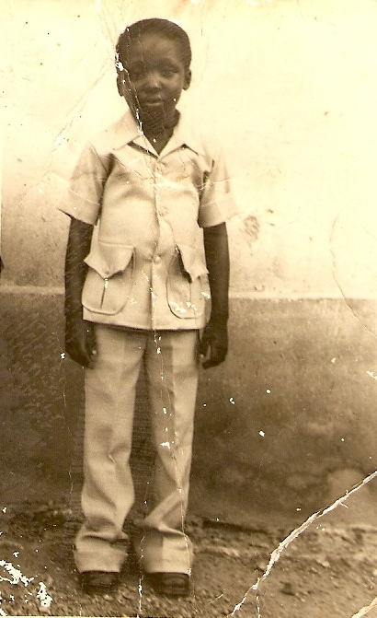
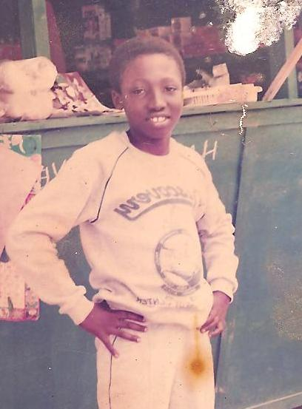
Albert Asante
Notes:
Always smiling. Always optimistic. Always looks for the positive

Slide 41
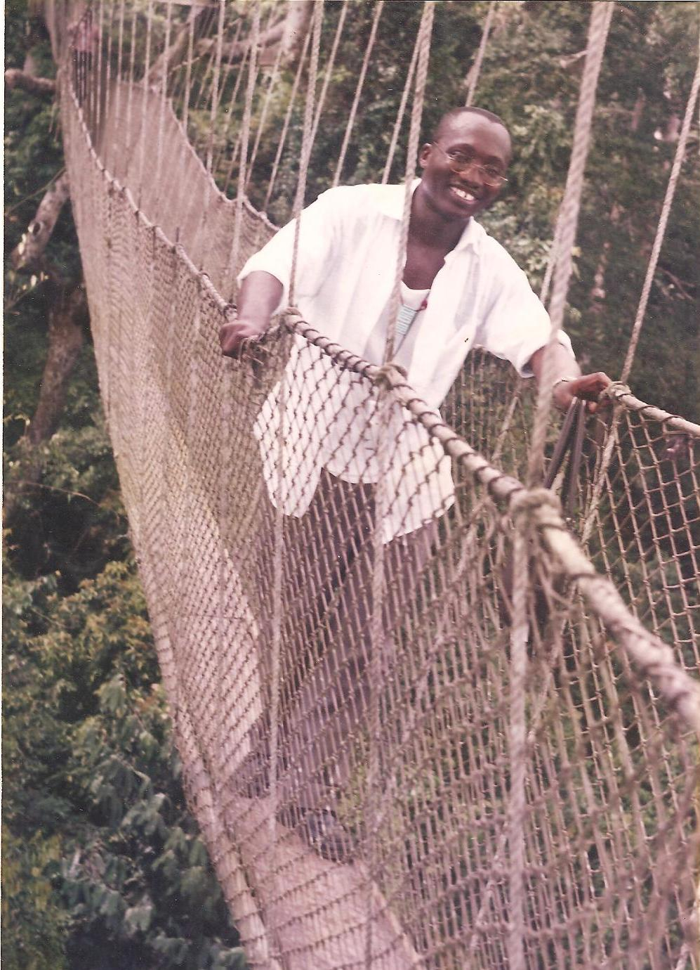
Notes:
Albert’s motto: “Don’t let anybody steal your joy”

Slide 42
Albert Asante…“The Professor”
GPA: 4.95
GPA: 7.99
Creog Score: 215
Creog Score: Too high, cannot compute
Notes:
Wise words from one of the smartest people I know.
In fact, Albert is so incredibly smart that Dr. White has nicknamed him the professor
GPA: 4.95
GPA: 7.9999999999
Creog Score: 215
Creog Score: Too high, cannot compute
VERY Impressive, Professor Asante

Slide 43
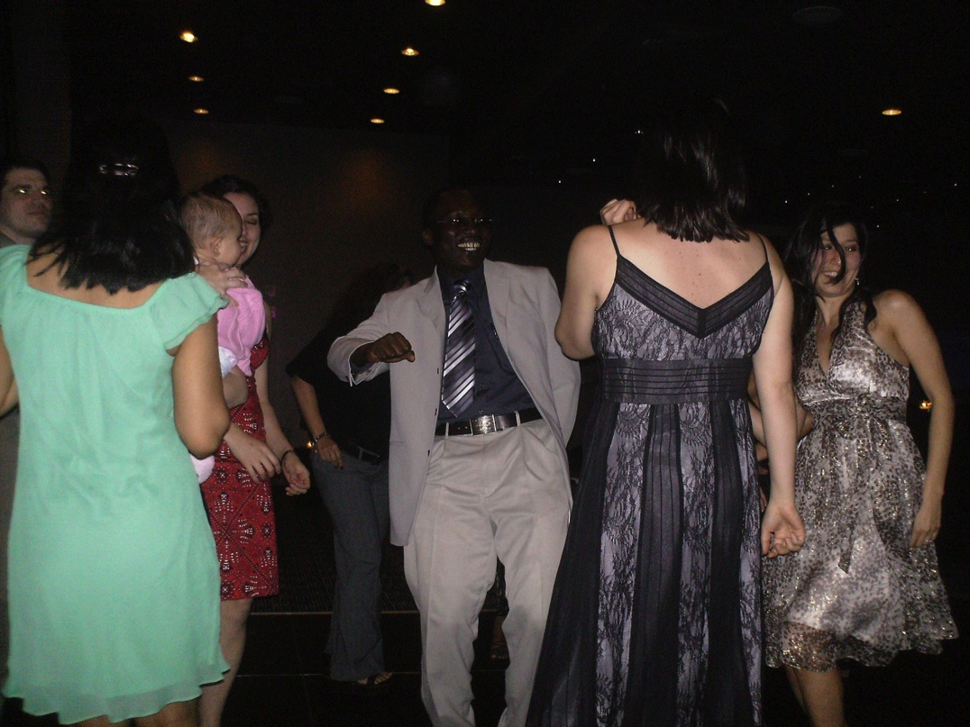
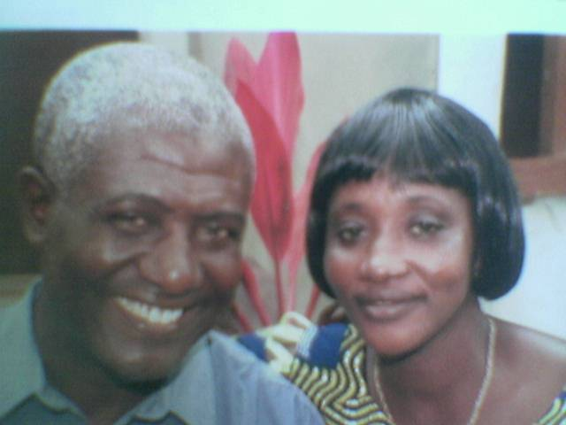
Albert…
Notes:
Loves his family
Loves dancing
Loves women

Slide 44
Albert
Oooohhhhh La La
Notes:
And just like Arnold…Albert obsesses over his body
It is probably an understatement when I say that Albert LOVES women.
But from this photo we can see why women love Albert.
Of course, we will all miss Albert when he leaves.
But, I assure you that - all the women in Atlanta will also miss Albert when he leaves for Minnesota.

Slide 45
Elective Oophorectomy in the United States: Trends and In-Hospital Complications, 1998–2006
Asante, Albert MD, MPH; Whiteman, Maura K. PhD; Kulkarni, Aniket; Cox, Shanna MSPH; Marchbanks, Polly A. PhD; Jamieson, Denise J. MD, MPH
Obstetrics & Gynecology:
November 2010 - Volume 116 - Issue 5 - pp 1088-1095
Notes:
Okay…let’s talk about Elective oophorectomy
So, for those of you that chosen to read Telinde’s – which is the world’s leading gynecology surgery reference for over 60 yrs
You know, the one that the famous Dr. John D. Thompson talked about at RRD – the one where he has been the editor on several occasions
-If you’ve chosen to read TeLinde’s about this very subject instead of Dr. Asante’s WONDERFUL article in the Green Journal (the one where n >2million), then I have copies of his article for you to read waiting at the exit doors
And don’t forget to pick them up on your way out!

Slide 46
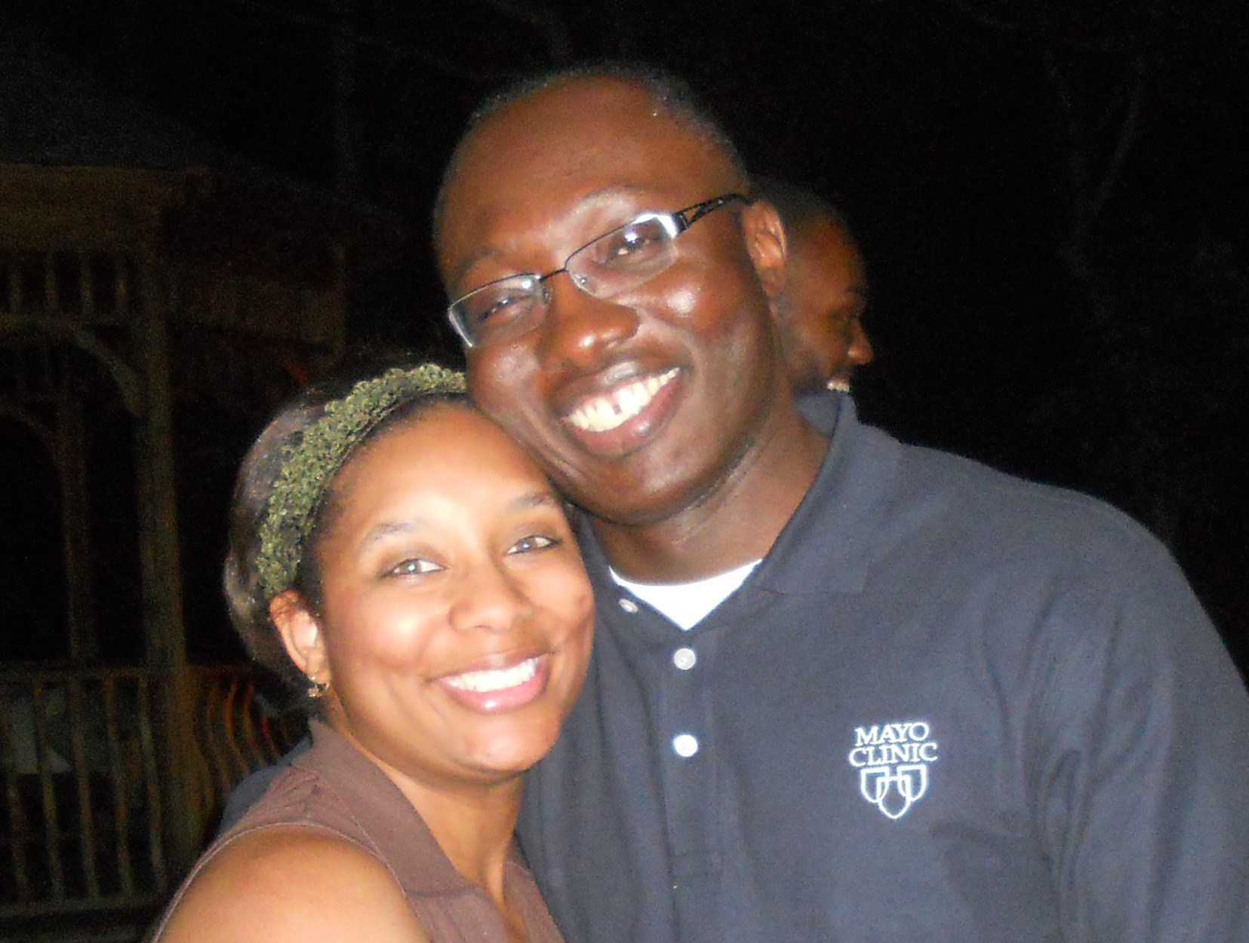
FRIEND

Slide 47
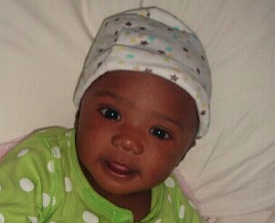
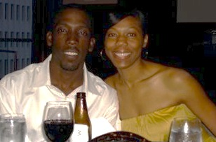
Lakisha Carter Eaton
Birthplace : Atlanta, Crawford Long Hospital
Hometown : Atlanta, Georgia
Undergraduate : University of Georgia
Medschool: University of Illinois at Chicago
Future plans: private practice at Eagles Landing OBGYN
Fun fact: I was a high school varsity cheerleader … yeah seriously

Slide 48
Top 10 things Now Know About Kisha…
1
She will never say a bad word behind your back!
No!....
she says it right to your face!

Slide 49
Top 10 things we now know about Dr. Carter
2
“…..you know, I hate foolishness! Need I say more?”!

Slide 50
Top 10 things we now know about Dr. Carter
3
wanted to do a fellowship in gyn-onc
- changed her mind after working with……

Slide 51
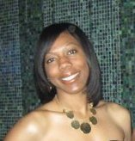
Top 10 things we now know about Dr. Carter
4
Dr. Spann has a crush on her……..,and calls her Beverly
Beverly Johnson

Slide 52
Top 10 things we now know about Dr. Carter
5
knows how to do a lot of things including giving great speeches but
…..doesn’t know how to do ppt presentations!
Examples:
- RRD 2009 and
- RRD 2011

Slide 53
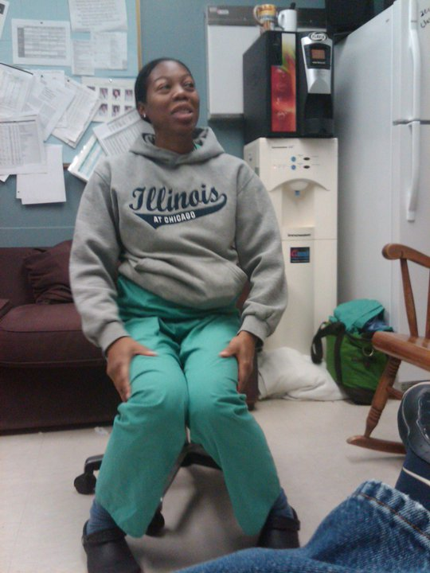
6
A great caring mom….
Used to eat every 2hrs and take a nap
4 times a day throughout her pregnancy!
Every room on L&D has a sign that reads….
“KNOCK B4 U ENTER!!!, I’M PUMPING BREAST
MILK”!!!

Slide 54
Top 10 things we now know about Dr. Carter
7
She had a gunshot pregnancy….expected due date was exactly 38wks after the wedding day
…..what was the day of conception?

Slide 55
Top 10 things we now know about Dr. Carter
8
She has a condition named after her….
the Eaton-Carter syndrome
…elevated endorphins→elevated hcg→
elevated PRL
= delay in taking USMLE step 3

Slide 56
Top 10 things we now know about Dr. Carter
9
Dr Carter hates EPIC….
for the wrong reason!
B’cos EPIC doesn’t allow her to show off her excellent penmanship

Slide 57
She can be very persuasive…..
She can get a total stranger to dance with her!!!
10

Slide 58
She is a true friend……….

Slide 59
Dana Marie Smith
Birthplace: Washington DC
Hometown: Columbia, MD
Undergrad: University of Maryland, College Park
Medschool: Northwestern University
“Fun Fact”: ???
Future Plans: MFM Fellowship at UNC Chapel Hill

Slide 60
Top things we’ve learned about Dana…

Slide 62
Things we know and love about Dana….
Consistently begins every conversation with “Gurl…”
One of the few people in whom “Murphy’s Law” is a daily occurrence.
Vegetarian of convenience (AKA Closet Carnivore)
…looks good doesn’t it, Dana!?!

Slide 63
Always somewhere else in her mind

Slide 64
As much as she does this:
…She should buy stock in apple

Slide 65
Everyone can always count on a random ‘S.O.S’ page from the operator about how she needs help,
but not to call her back because she can’t find her
phone…or it’s just dead!
Quiet overachiever: Mistress of Procrastination, but can still secure an award ‘clean sweep’ at RRD 2010
HELP!!!

Slide 66
Arthur Jason Vaught, III
Birthplace: Memphis, TN
Hometown: Memphis, TN
Undergrad: University of Missouri Kansas City
Medschool: University of Missouri Kansas City
“Fun Fact”: I can do a really good Michael Lindsay, MD impersonation.
Future Plans: Critical Care Fellowship at the University of Florida

Slide 67
Top things we’ve learned about Jason…
Reputation for sleeping around
Metrosexual wardrobe… SWEATERS?
Knowledge of class contraception
Sagging scrub pants
Male model

Slide 68
Top things we’ve learned about Jason…

Slide 69
Top things we’ve learned about Jason…

Slide 70
Top things we’ve learned about Jason…

Slide 71
Top things we’ve learned about Jason…
Reputation for sleeping around
Metrosexual wardrobe…SWEATERS?
Knowledge of class contraception
Sagging scrub pants
Male model
Long list of potential careers
Never a dull moment
Maturing into a fine young physician!

Slide 72
A Few Insights From The Pgy 1-3’s . . .

Slide 73
Superlatives as voted by the PGY1-3’s
Most likely to sleep through a robotic case…
Kisha Eaton
Most likely to be M.I.A.
Albert Asante
Most likely to call a c-section
Betsy Collins
Least likely to call a c-section
Dana Smith

Slide 74
Superlatives as voted by the PGY1-3’s
Most likely to wrestle the anesthesiologist to the ground ...
Rebecca Williams
Runner-up: Betsy Collins
Most likely to wrestle the neonatologist to the ground...
Jason Vaught
Runner-ups: Katie and Betsy
Most likely to make a grand entrance after sign-out has begun...
Albert Asante
Runner-up: Jason Vaught

Slide 75
Superlatives as voted by the PGY1-3’s
Most likely to “debate” patient care with an attending...
Katie, Betsy, Shontell, Jason
Most likely to be talking, texting, and driving simultaneously...
Rebecca Williams
Runner-up: Jenn Kawwass
Most likely to prolong sign-out by 30 minutes...
Shontell & Jason

Slide 76
Superlatives as voted by the PGY1-3’s
Most likely to be heard on 4J while on 4L...
Rebecca Williams
Most likely to have a surgical instrument named after her/him...
Albert Asante
Despite noise and wucc patients, most likely to be able to take a long nap on the 4th year couch...
Kisha, Jason, Jenn
Most able to pull off the fashionable “low-riding” scrubs...
Jason Vaught

Slide 77
Superlatives as voted by the PGY1-3’s
Most likely to be found reading people magazine or US weekly instead of TeLinde’s...
Kisha Eaton
Runner-ups: Jenn and Rebecca
Most likely to go on a date in scrubs...
Jason Vaught
Runner-up: Albert
Best dressed at Grady Continuity Clinic
Jenn Kawwass

Slide 78
Superlatives as voted by the PGY1-3’s
Best hair...
Dana & Shontell
Most pristine white cloud...
Jenn and Dana
Darkest black cloud...
Betsy Collins
Most likely to replace Dr. Horowitz as chair of the department someday...
Katie Groendyke

Slide 79
Emory University
Thank You!!!
2011 Department of Gynecology & Obstetrics Graduation and Awards Banquet
June 10, 2011

